Slide 1
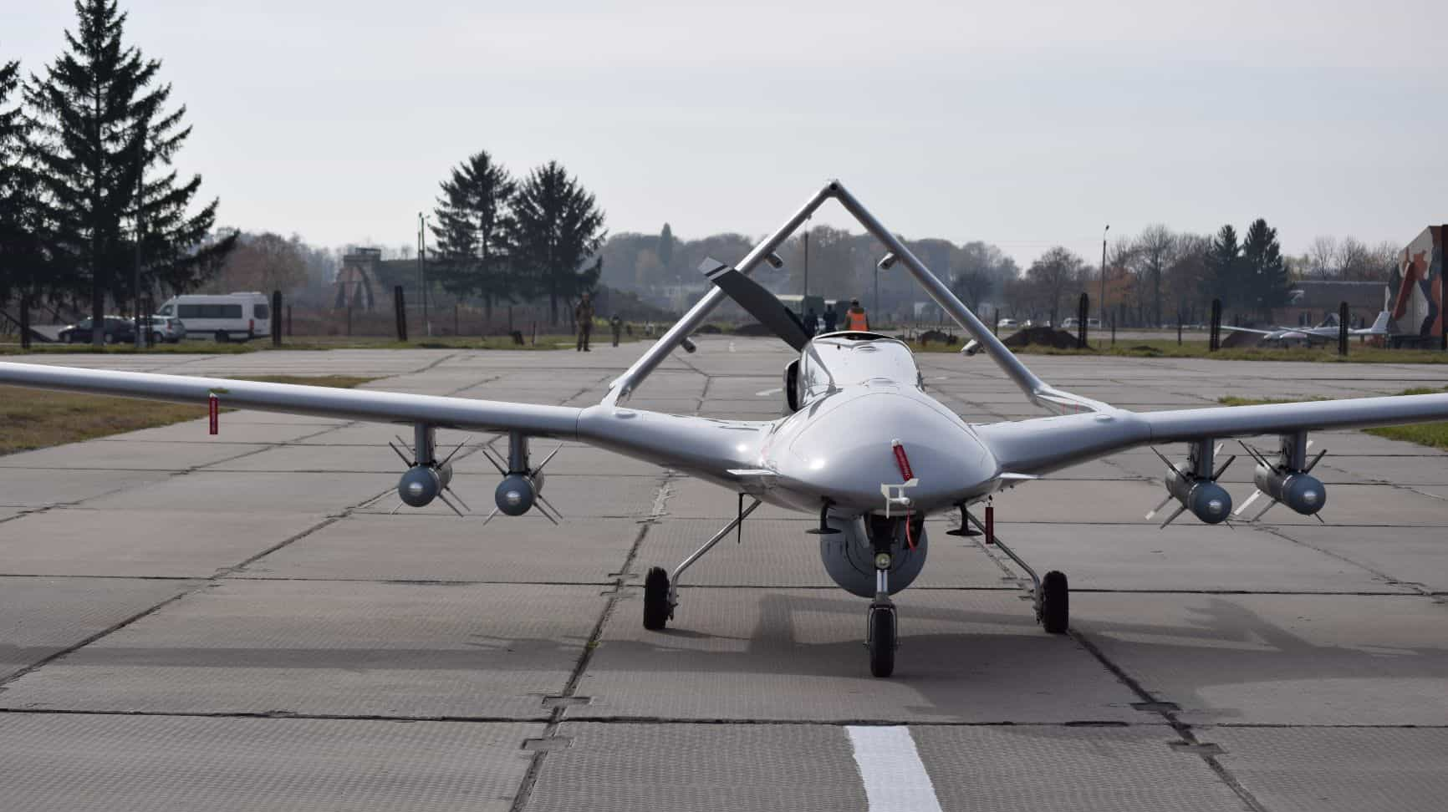
Unmanned Aerial Vehicle (UAV)
Name: Amirul Haikal Bin Shahrin
Matric Number: 1912521

Slide 2
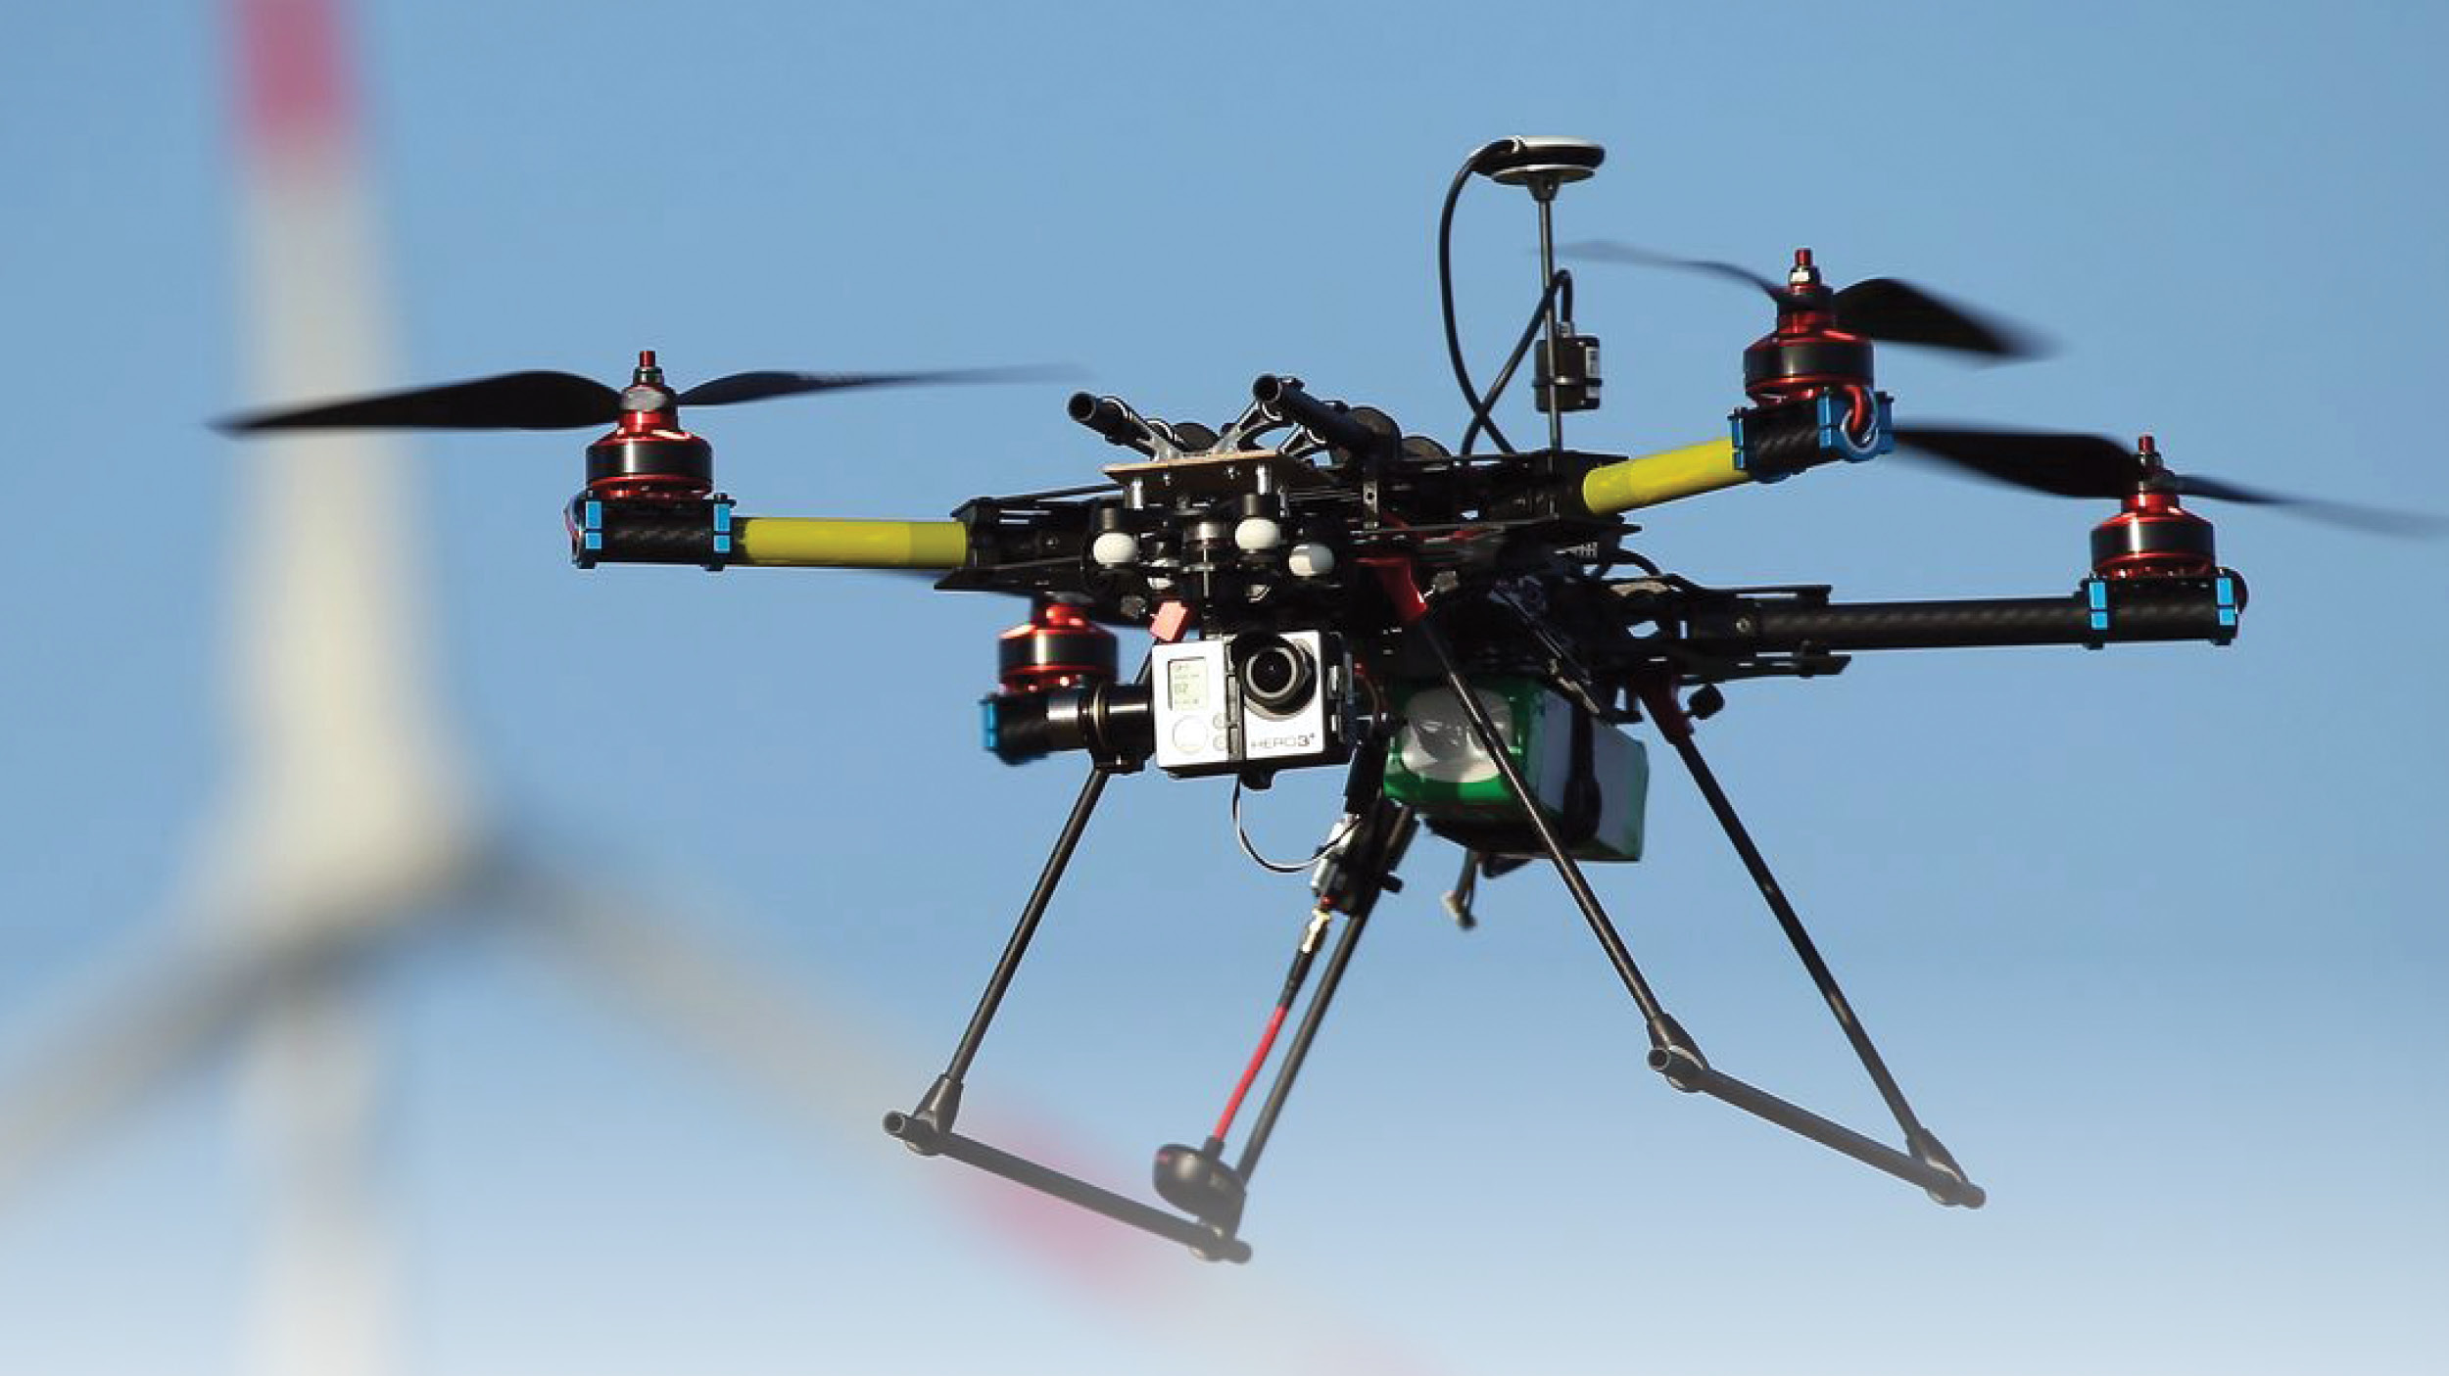
Introduction
An unmanned aerial vehicle (UAV), commonly known as a drone, is a type of aircraft that operates without a human pilot on board. UAVs are equipped with a variety of hardware components that allow them to perform various tasks, from surveillance and reconnaissance to package delivery and search and rescue operations.
In this presentation, we will discuss some of the essential hardware components of UAVs and provide examples of each component.

Slide 3
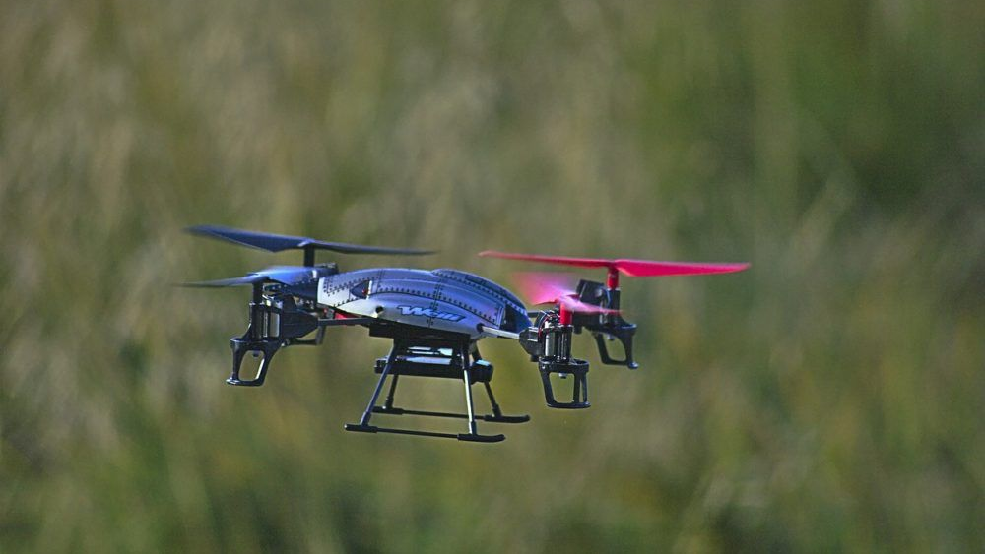
Main Components
Frame
Locomotion (Motor & Propellers)
Control System (Flight Controllers)
Data Collection (Sensors)
Data Collection (Camera)
Data Transmission
Power Management

Slide 4
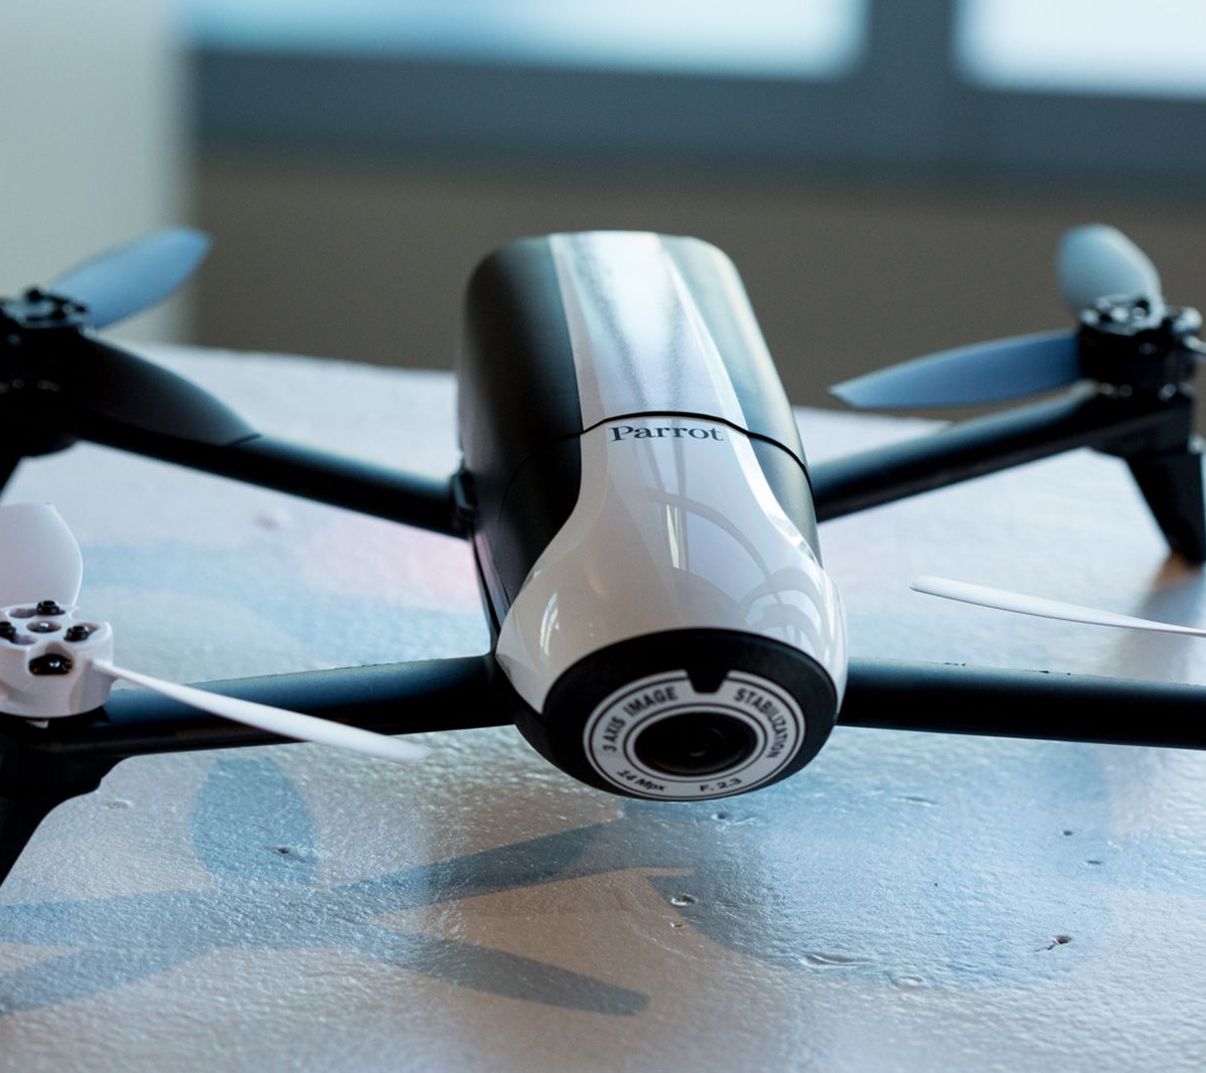
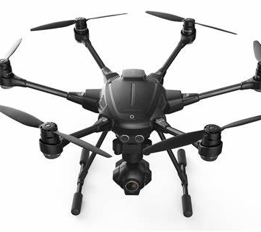
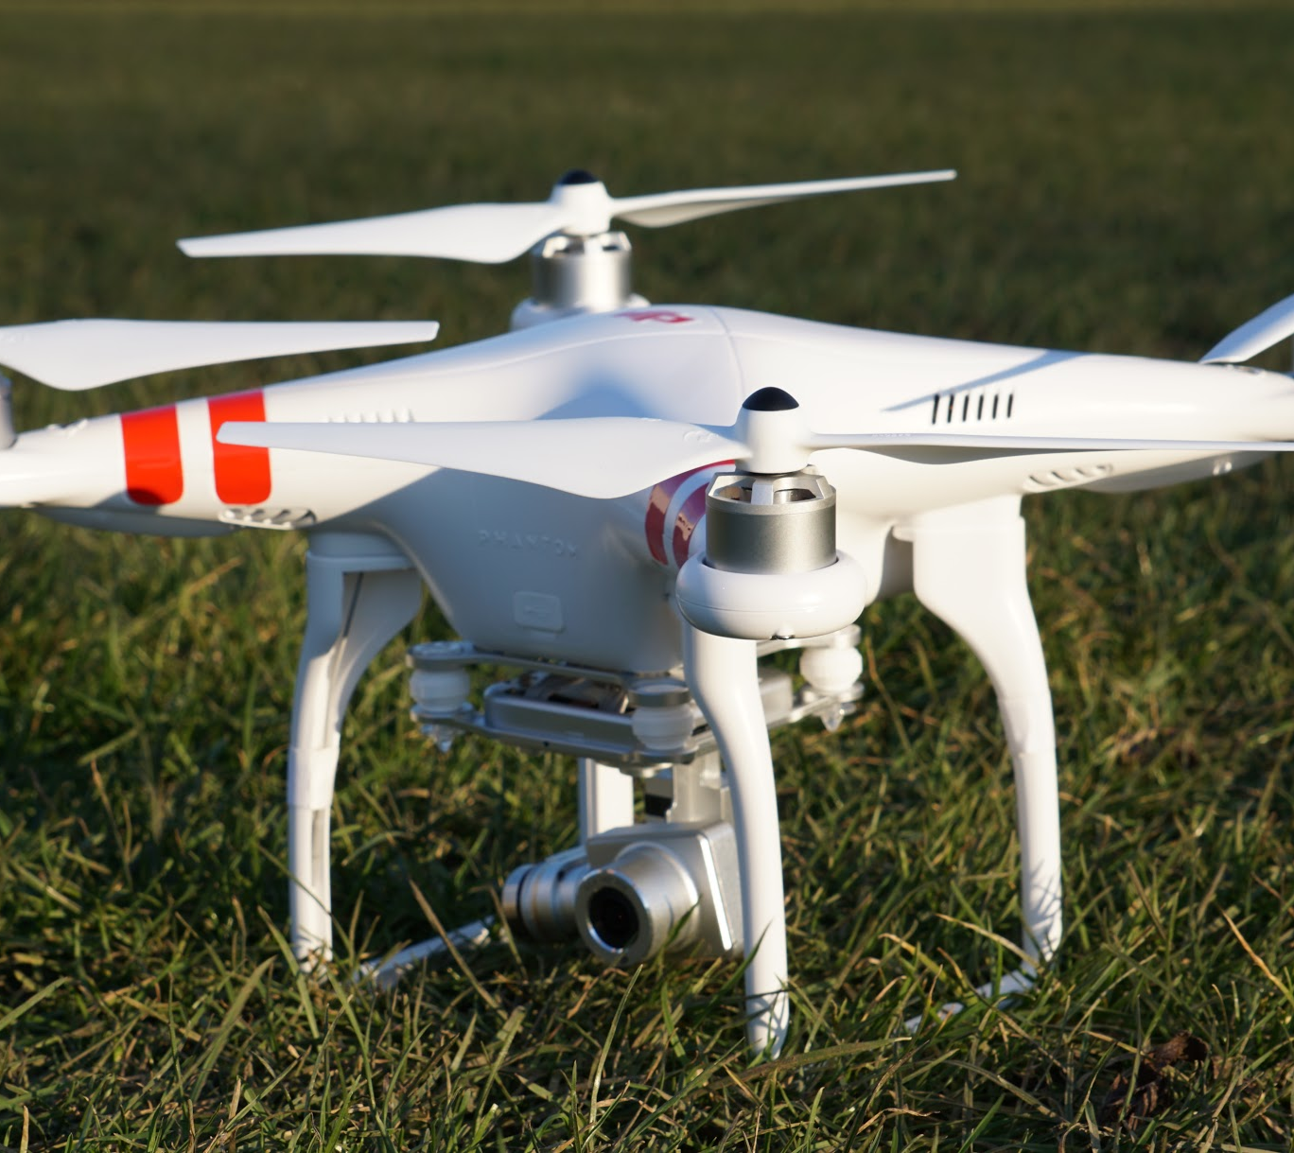
Frame
Parrot Bebop
Yuneec Typhoon H
DJJ Phantom 4
The frame is the physical structure of the UAV that holds all the components together.
The frame is usually made of lightweight materials such as carbon fiber or aluminum, and it is designed to be aerodynamic and durable.

Slide 5
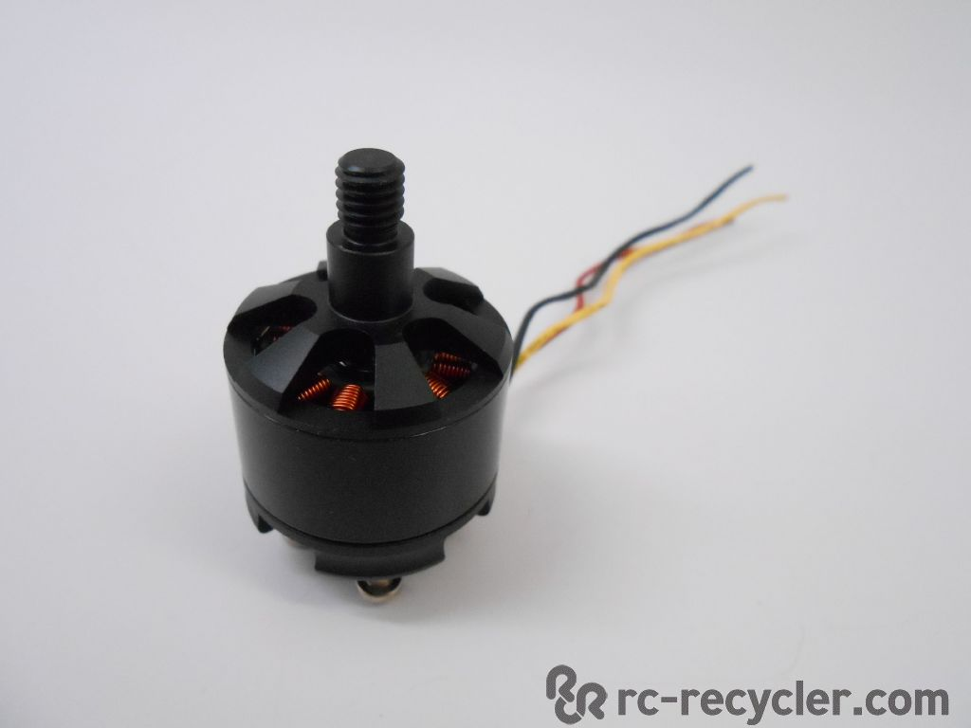
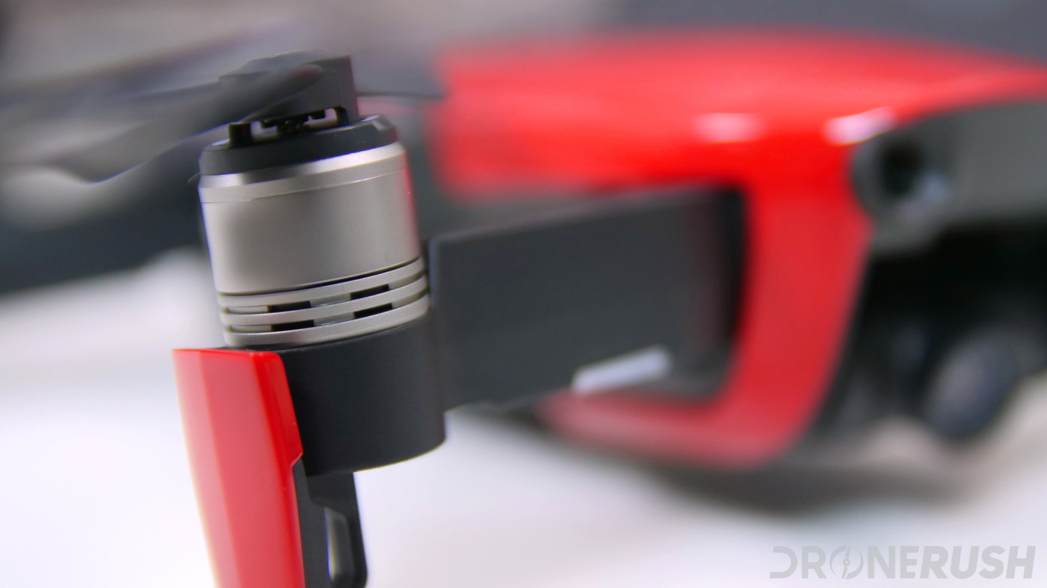
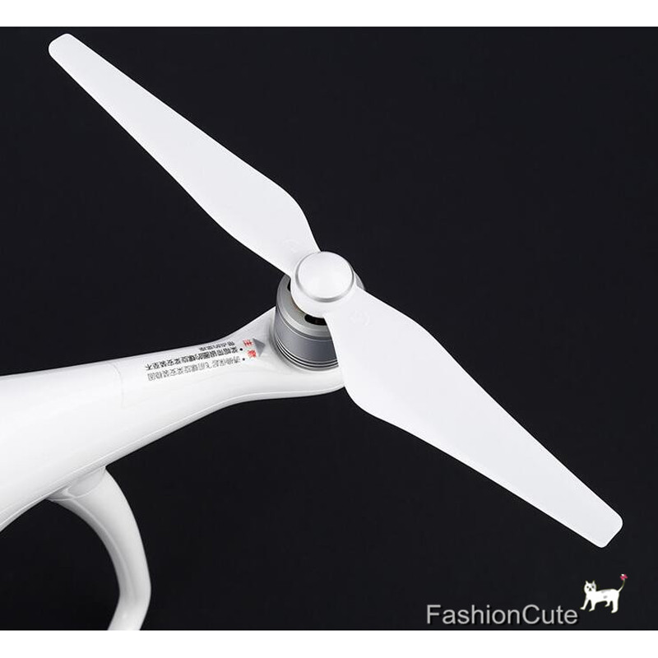
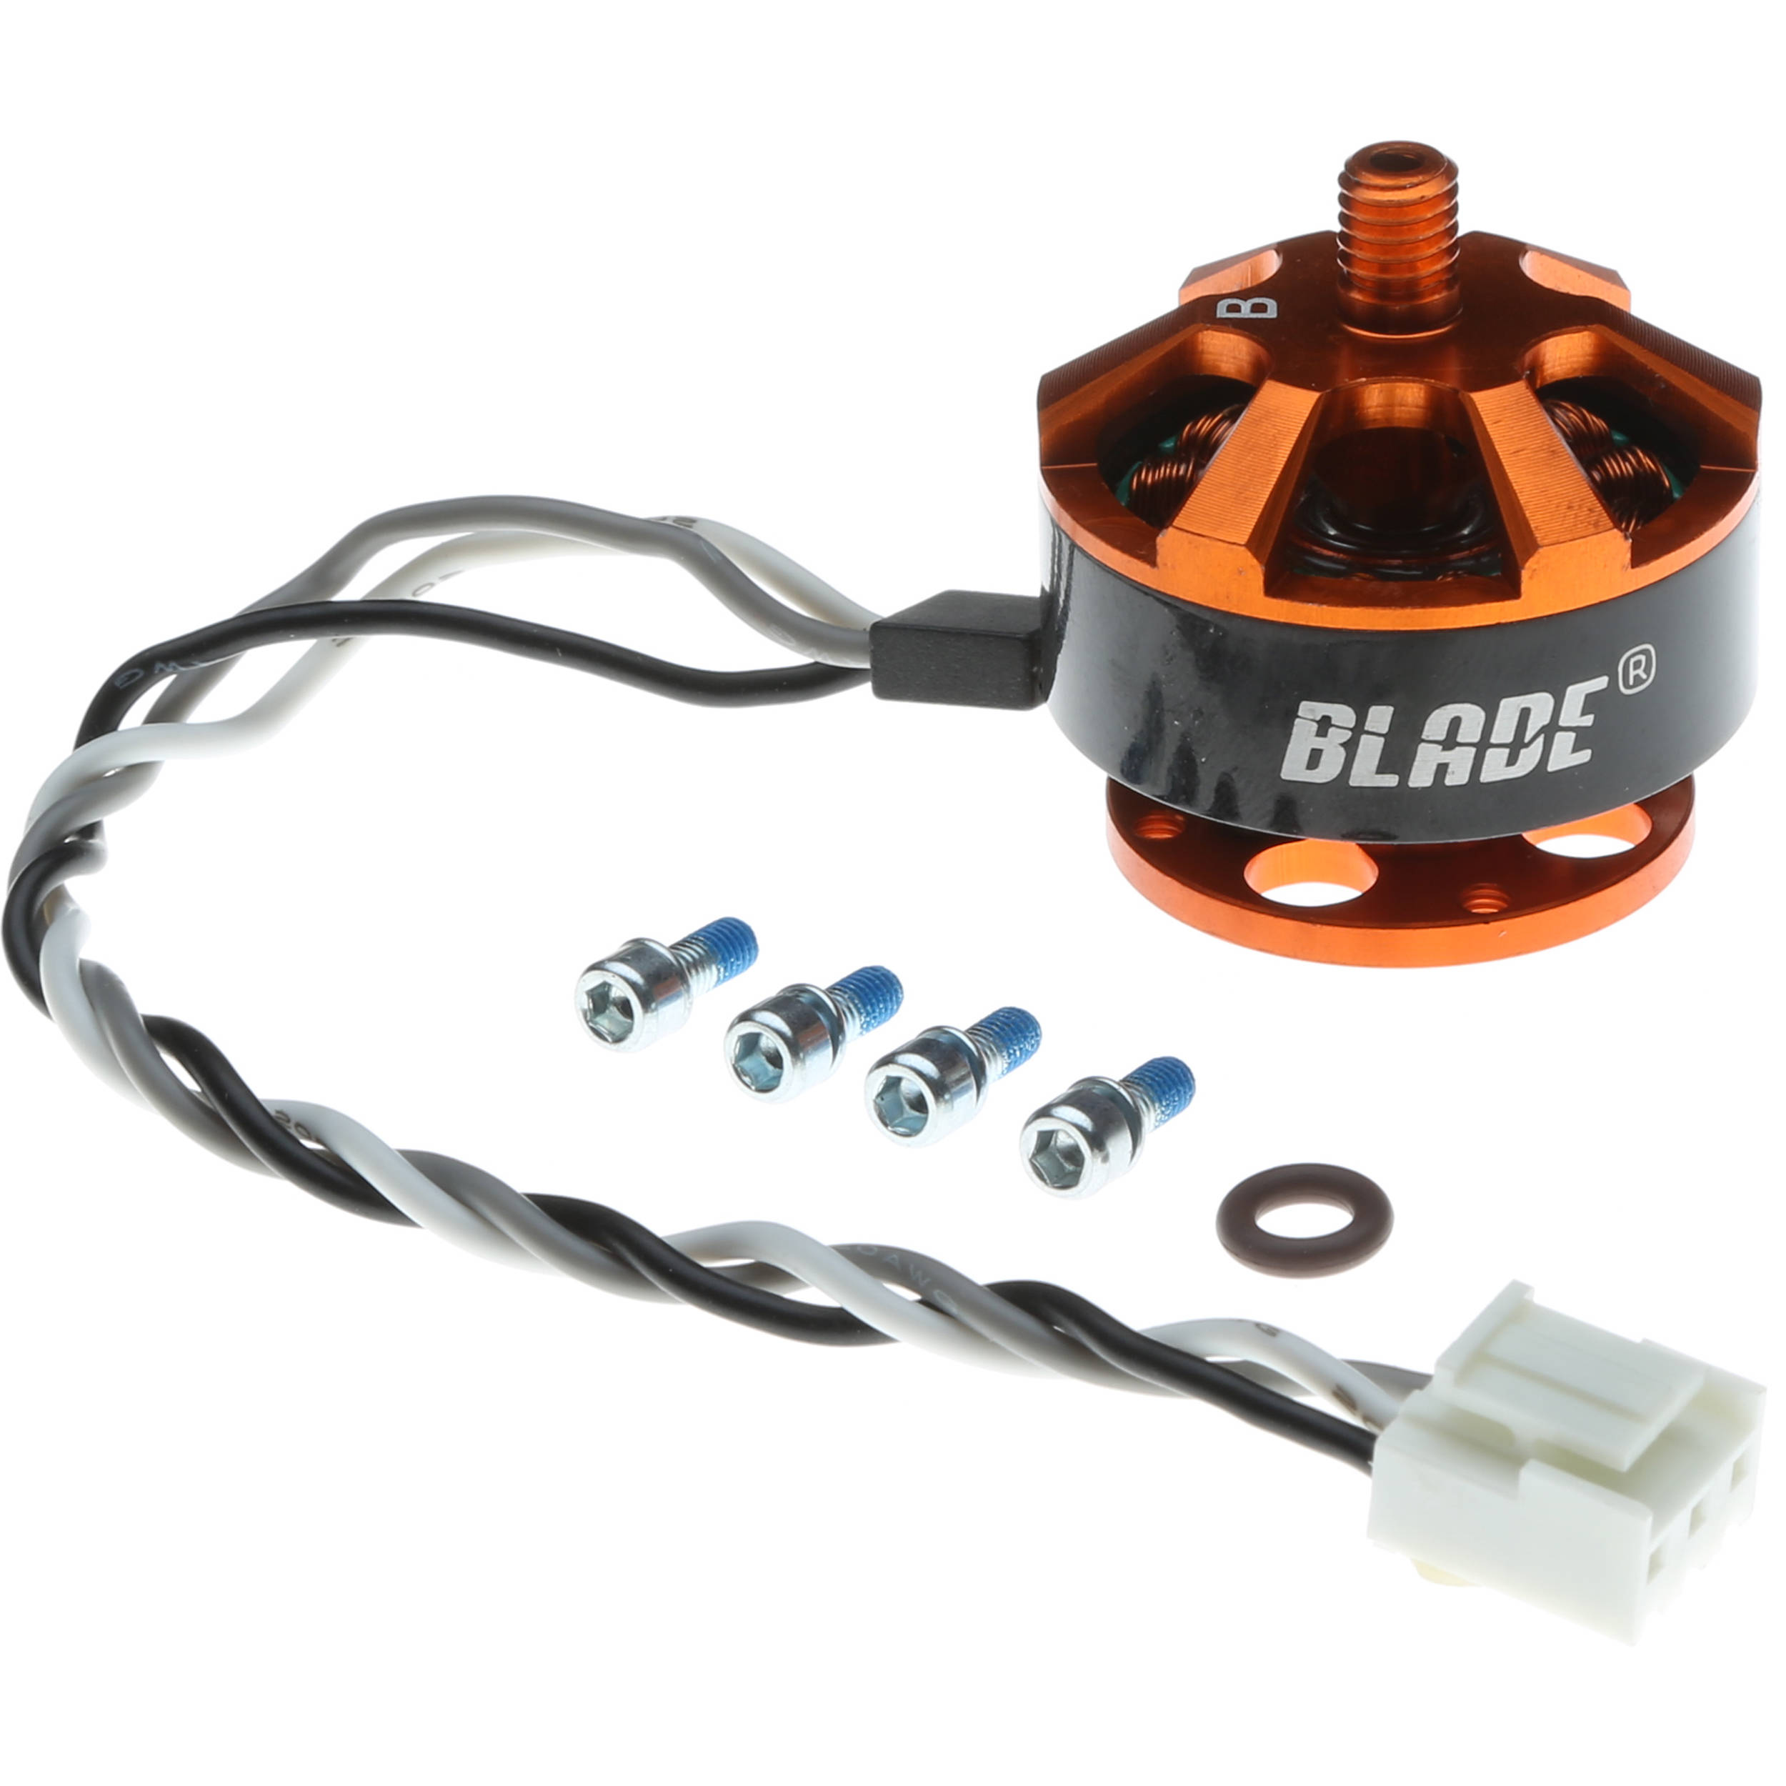
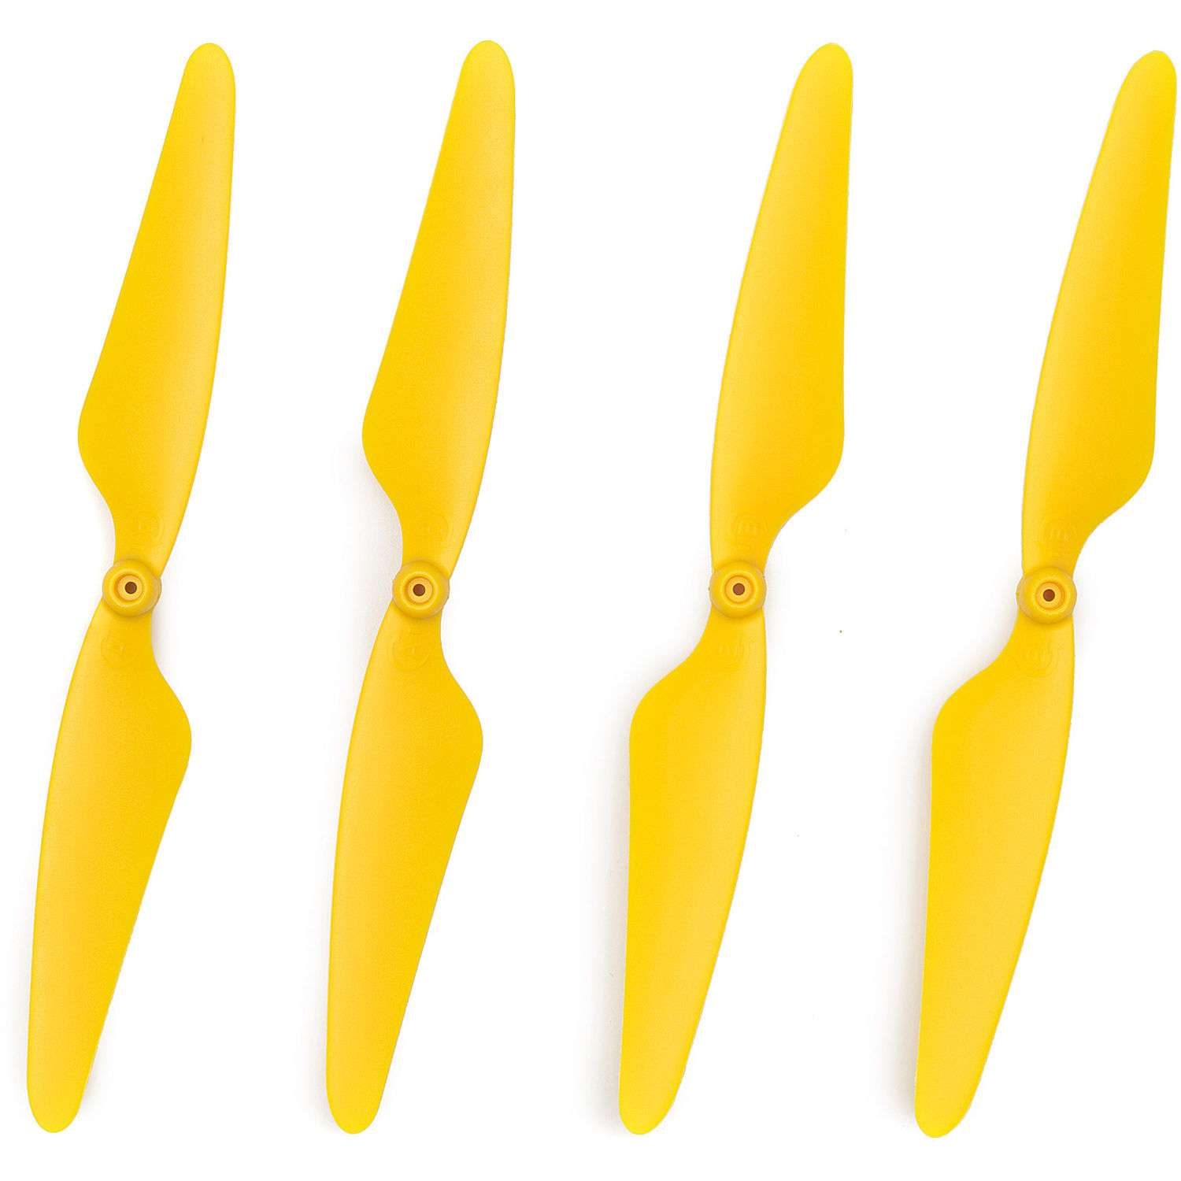
Locomotion (Motor &Propellers)
DJI Mavic Air Motor & Propeller
Autel Robotics X-Star Premium CCW Motor
The motors are responsible for propelling the UAV through the air. UAVs typically have four or more motors, each connected to a propeller.
The motors are controlled by the flight controller, which determines the speed and direction of each motor.
The propellers are attached to the motors and generate the lift required to keep the UAV in the air.
Propellers come in various sizes and shapes, depending on the type and size of the UAV
DJI Phantom 4 4Pro 4Pro+ 9450 Quick Release Propellers 9450S Blade
BLADE BLH8612 brushless motor for Chroma
HUBSAN Propeller Set for X4 H507A Star Pro Drone H507A-03 B&H

Slide 6
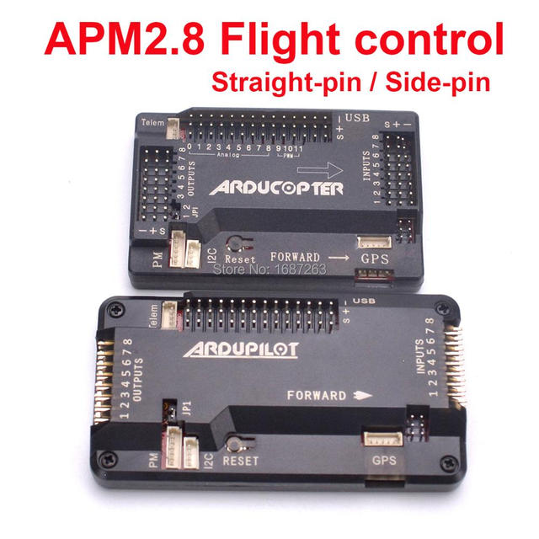
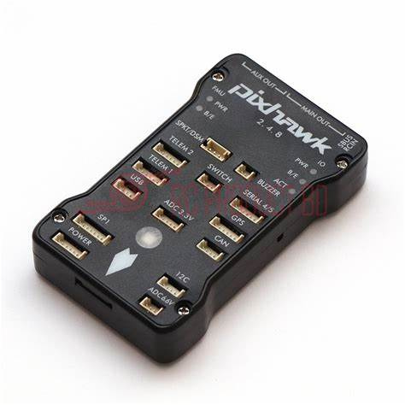
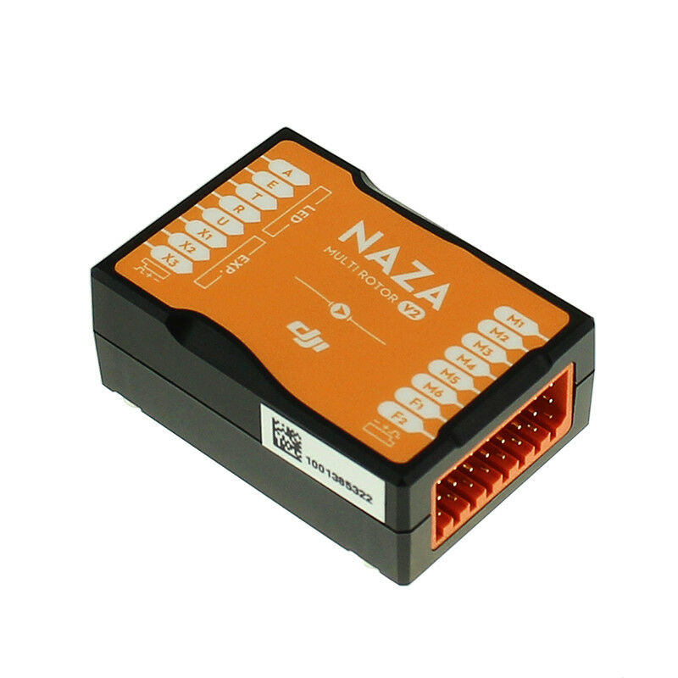
Control System (Flight Controller)
The flight controller is the brain of the UAV. It receives input from various sensors, including the GPS, gyroscope, and accelerometer, and determines the orientation and speed of the UAV.
The flight controller also controls the motors and other components of the UAV.
Pixhawk PX4 Autopilot
DJI NAZA-M V2

Slide 7
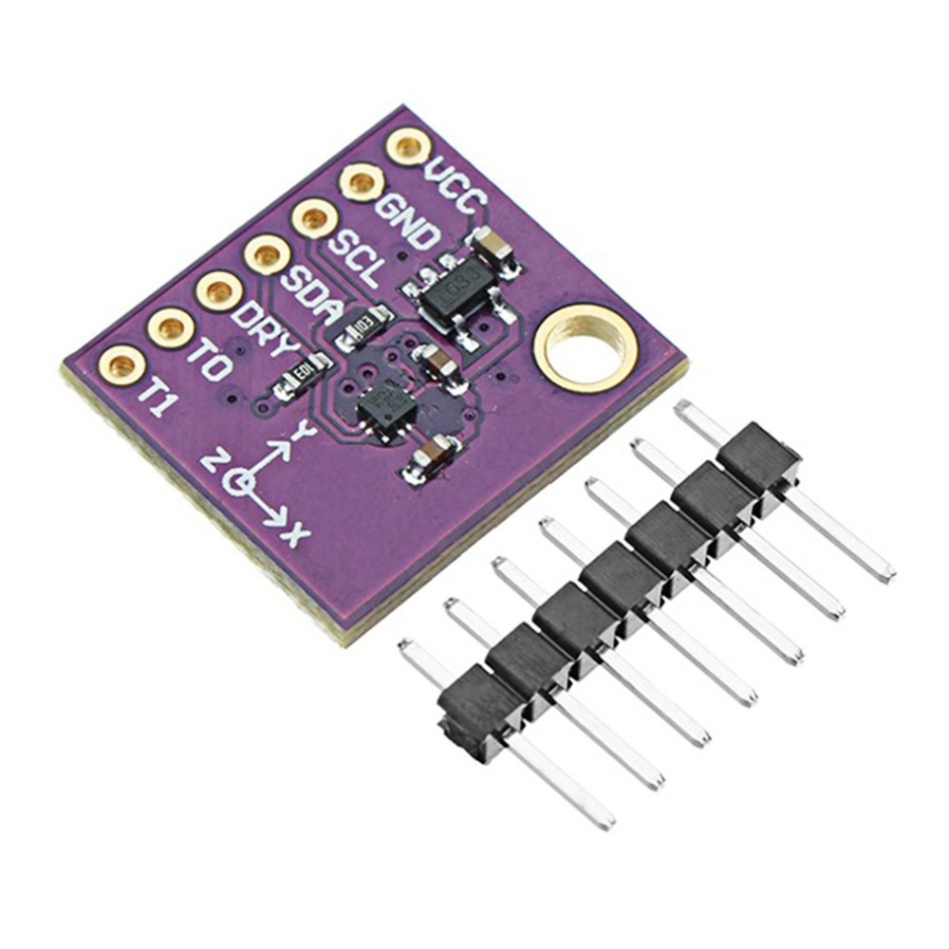
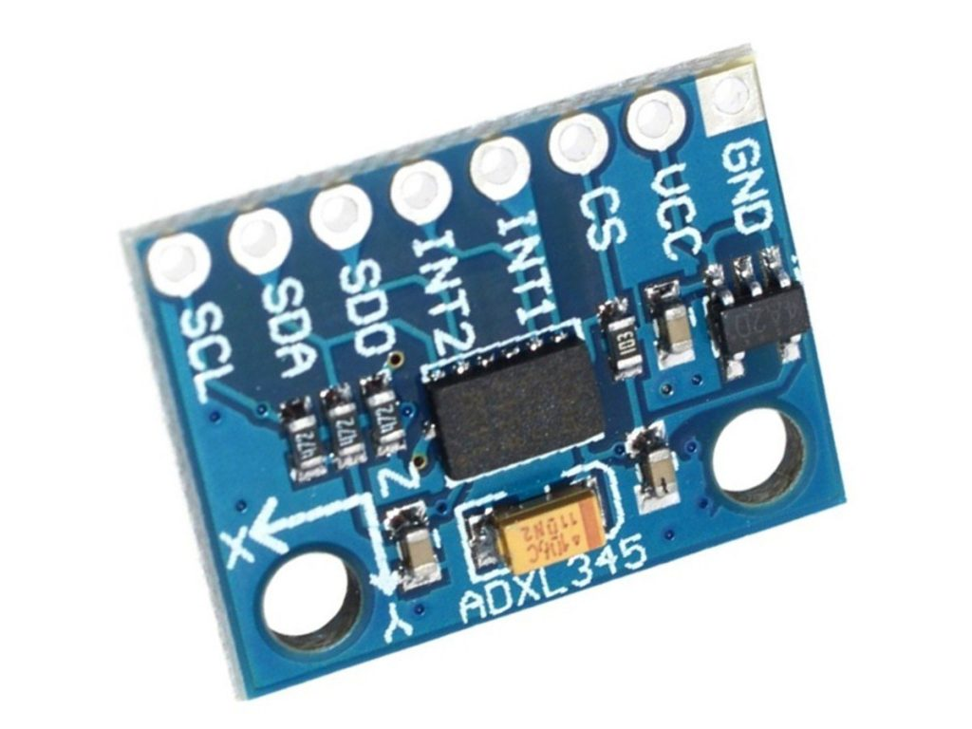
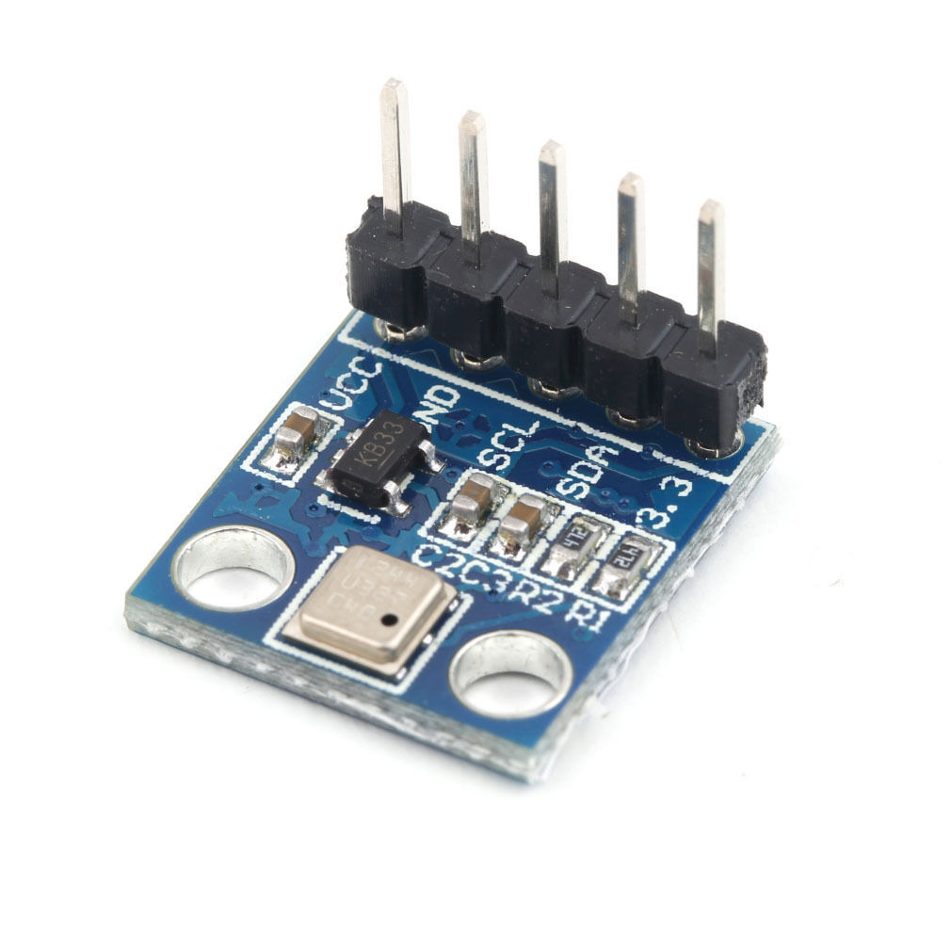
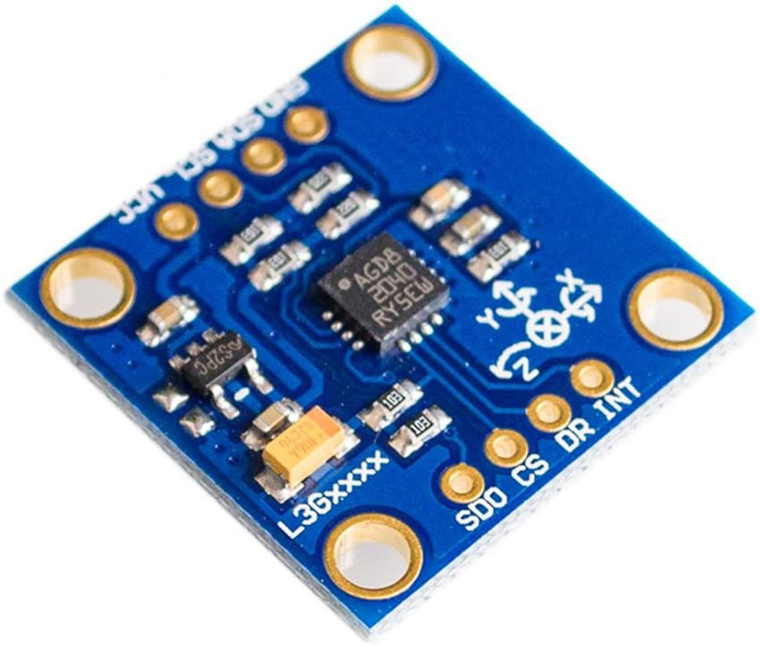
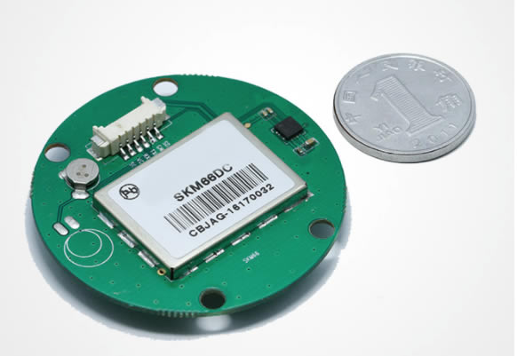
Data Collection (Sensors)
ADXL345 3-Axis Accelerometer Sensor Module
UAVs are equipped with various sensors that provide information about the environment, such as altitude, airspeed, and temperature.
Sensors also provide data for navigation and obstacle avoidance.
CJMCU 008 HSCDTD008A 3 Axis Magnetometer Compass Magnetic Sensor
BMP180 Barometric Pressure Sensor
GY-50 L3G4200D 3 Axis Digital Gyroscope Sensor Module
GPS Module with Antenna for UAV-Tenet Auto Electronics Limited

Slide 8
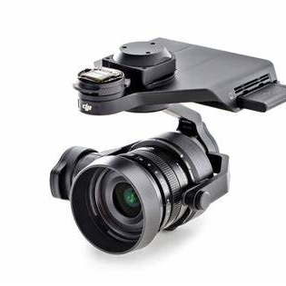
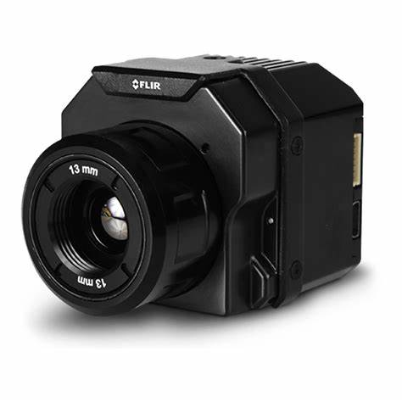
Data Collection (Camera)
The camera is one of the most critical components of the UAV, as it provides visual information to the operator or onboard computer.
UAVs can be equipped with various types of cameras, including thermal, infrared, and high-definition cameras.
DJI Zenmuse X5
FLIR Vue Pro R

Slide 9
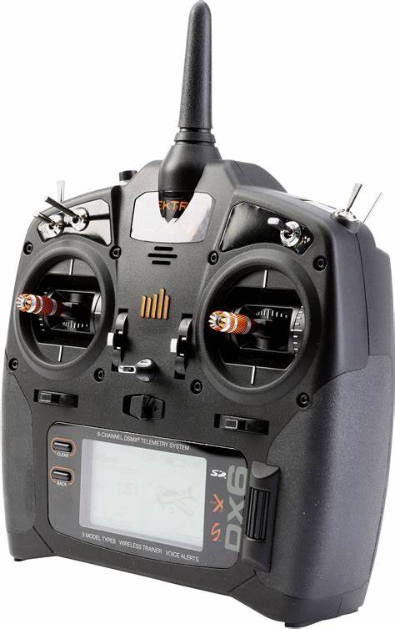
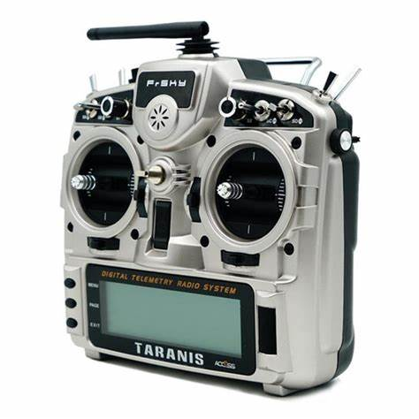
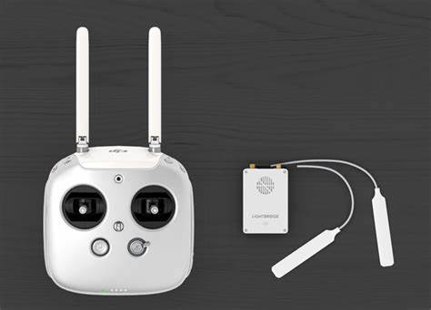
Data Transmission
DJI Lightbridge 2
Spektrum DX6e
FrSky Taranis X9D Plus
The communication system allows the operator to control the UAV remotely and receive data from the UAV in real-time.
UAVs use various communication systems, including Wi-Fi, Bluetooth, and radio frequency.

Slide 10
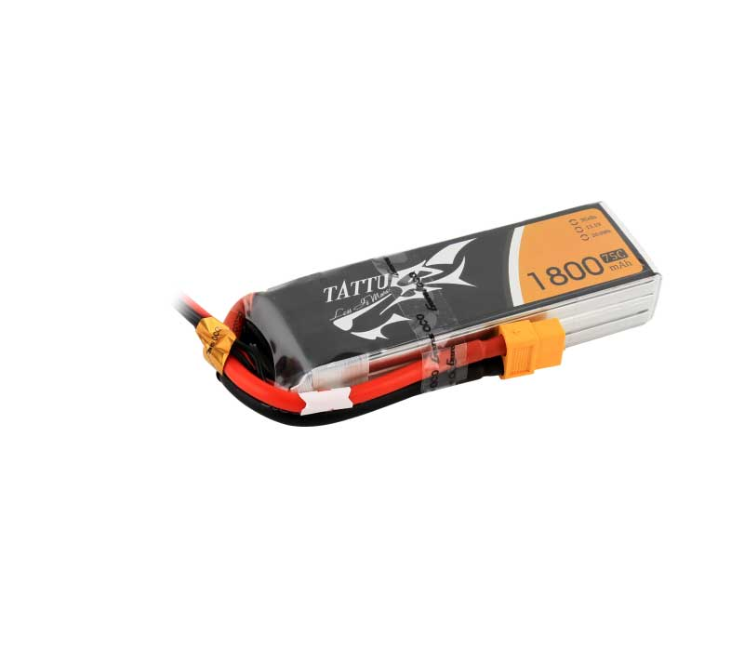
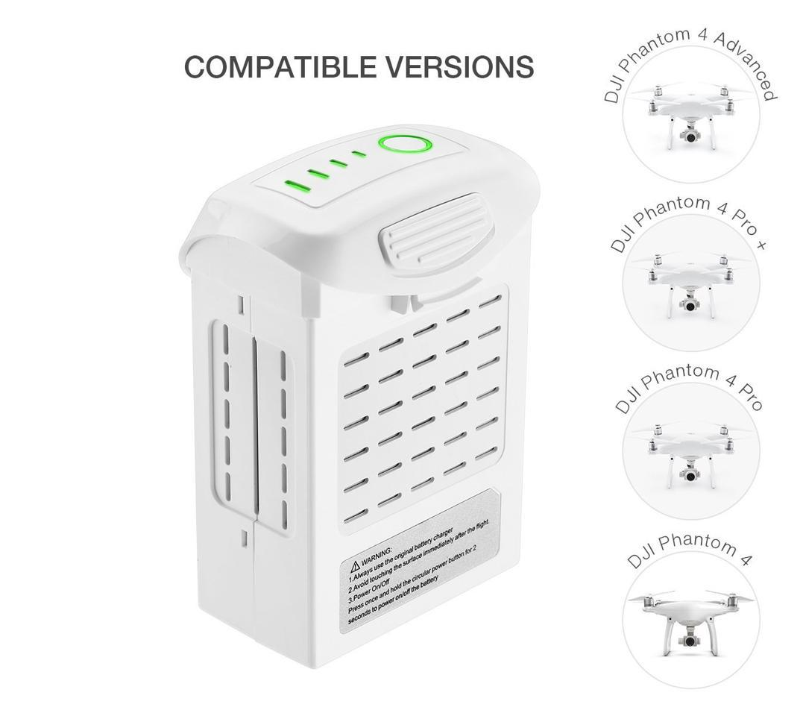
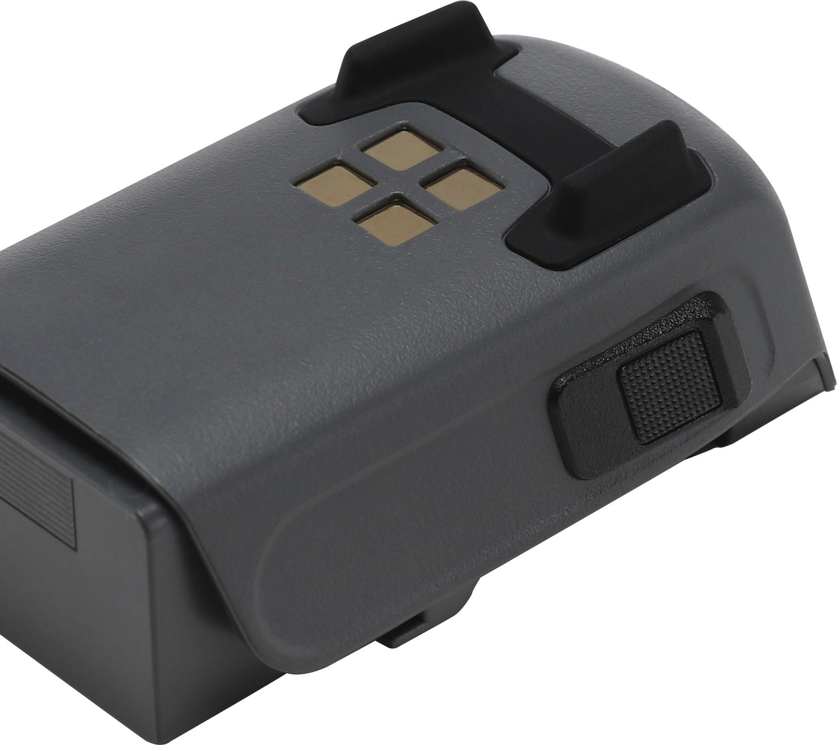
Power Management
The battery provides power to the motors and other components of the UAV. The battery must be lightweight, durable, and have a high capacity to allow the UAV to fly for an extended period.
Tattu 1300mAh 11.1V 75C 3S1P Lipo
Powerextra Phantom 4 Series Battery 15.2V 5350 mAh LiPo
DJI Intelligent Flight Battery for Spark CP.PT.000789

Slide 11
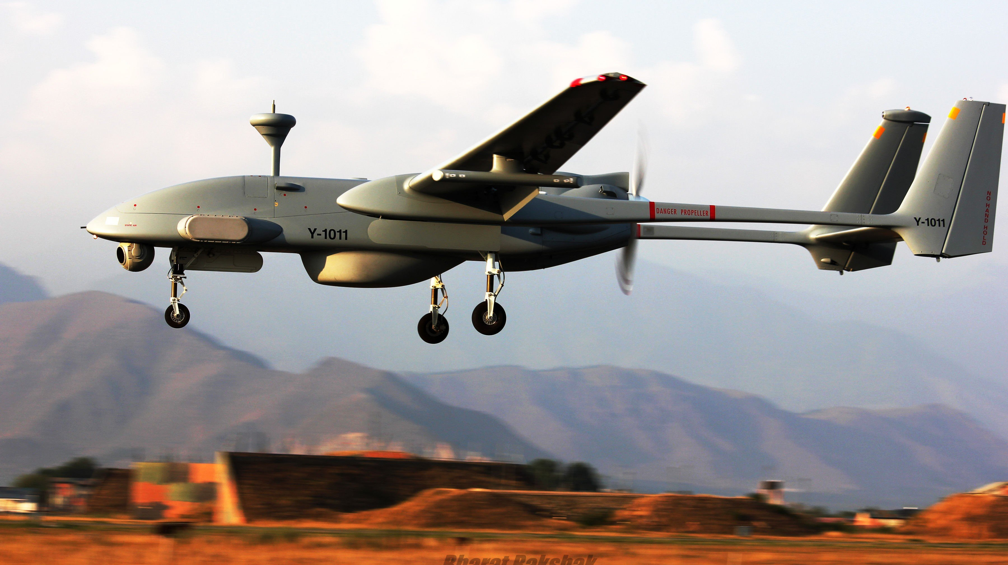
Summary
In conclusion, unmanned aerial vehicles are complex machines that require a wide range of hardware components to operate successfully. The hardware components discussed in this presentation are just a few examples of the many components that make up a UAV. Other components, such as sensors, antennas, and landing gear, are also essential to the operation of UAVs.

